Slide 1

ahaj
EMBEDDED SYSTEMS INTERNSHIP
Microcontroller-Based Washing Machine
Simulation Using Picsimlab
Team Members: Project Mentor:
R.GANESH JAYALAXMI N.DHANYAL
Sk.ARIEF
K.CHANDANA
P.GURUSAI
DEPARTMENT OF ELECTRONICS AND COMMUNICATION ENGINEERING( ECE )
3rd years of SRI VENKATESWARA ENGINEERING COLLEGE, Tirupati,517507.

Slide 2
USE OF C LANGUAGE
1.C programming is the Basic language.
2.Used in software Development.
3.Used in Embedded software Development.
4.Efficiency is high while comparing to remaining languages.
5.OS kernel Development.

Slide 3
Code Structure
#include<stdio.h> ⇐Preprocessor Directive
int main() ⇐The start of program
{
/* To Display Hello World */ ⇐comment
printf(“ HelloWorld \n ”); ⇐statement
return 0; ⇐return statement
}

Slide 4
Number Systems conversions
1.A number is generally represented as
Decimal
Octal
Hexadecimal
Binary
Type | Range ( 8 bits )
Decimal | 0 - 255
Octal | 000 - 0377
hexadecimal | 0x00 - 0xFF
Binary | 0b00000000 - 0b11111111

Slide 5
Data Representation
1.Bit Representation: High & Low states such as 1 & 0.
2.Byte Representation: A unit of Digital Information.
Commonly 1 byte = 8 bits
3.Word Representation: An Amount of data that a machine can fetch and process at one time.
Example: An integer no of bytes is 1,2,4,8.
For 32 bit chip has a 32 bits( 4 bytes ) word size
4.Integer Number - positive
Mathematically: -k=2^n - k
1st bit in 8 bits represents positive or negative integer.

Slide 6
What is an Embedded System ?
1.It is the combination of Hardware and software which is designed to perform a specific task.
2.Hardware components has become cheap.
3.They are available in abundance.
4.Components have been miniaturized.
Examples for Embedded system: Washing Machine
Microwave oven
Smart Refrigerators
WIFI modem
Wearables & Hospital Equipments: Smart watches, Fitness devices, ECG.

Slide 7
Commonly Seen Components
1.ROM - Read Only Memory / Primary storage device
2. RAM - Random Access Memory / Secondary storage device
3.Microprocessor
4.Microcontroller
5.Actuators
6.Sensors
7.Power supply
8.Motors

Slide 8
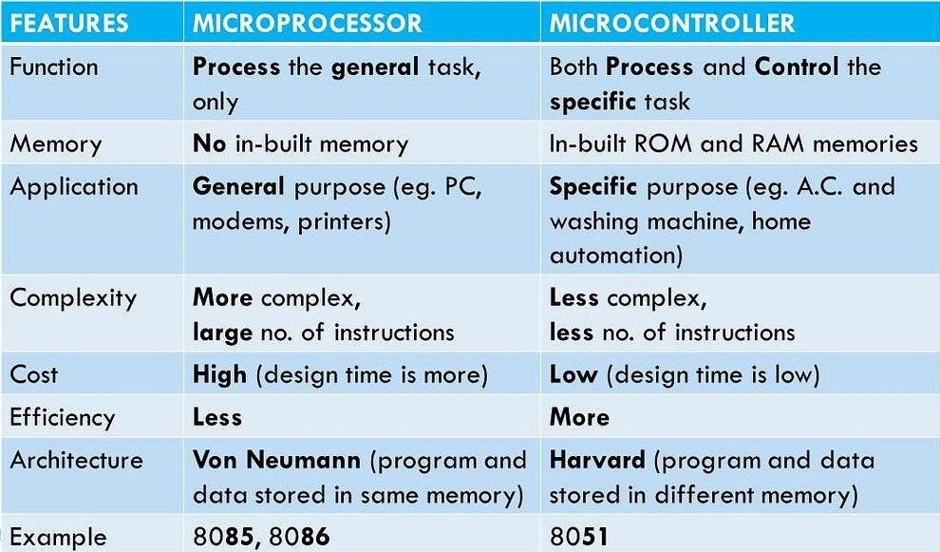
Difference Between Microprocessor & Microcontroller

Slide 9
Basic Data types
Data types
Char ( 1 byte )
Integer
Int ( 2 or 4 bytes )
Float ( 4 bytes )
Floating point
Double ( 8 bytes )

Slide 10
Conditional Constructs
1. Conditional constructs are classified into 2 types
Single iteration
Multi iteration
2.Single iteration
If
If else
Nested if else
Switch case
3.Multi iteration
For
While
Do while

Slide 11
Single iteration
1.If statement syntax:
if (condition) {
// block of code to be executed if the condition is true
}
2.If else statement syntax:
if (condition) {
// block of code to be executed if the condition is true
}
Else{
//block of code to be executed if the condition is false
}

Slide 12
Single iteration
3.Else if statement syntax:
if (condition1) {
// block of code to be executed if condition1 is true
} else if (condition2) {
// block of code to be executed if the condition1 is false and condition2 is true
} else {
// block of code to be executed if the condition1 is false and condition2 is false
}

Slide 13
Single iteration
4. Switch case statement syntax:
switch (expression) {
case x:
// code block
break;
case y:
// code block
break;
default:
// code block
}

Slide 14
Multi iteration
1.For loop statement syntax:
for (expression 1; expression 2; expression 3) {
// code block to be executed
}
2.while loop statement syntax:
while (condition) {
// code block to be executed
}

Slide 15
Multi iteration
3.do while loop statement syntax:
do {
// code block to be executed
}
while (condition);

Slide 16
Operators
C divides the operators into the following groups:
Arithmetic operators
Assignment operators
Comparison operators
Logical operators
Bitwise operators
Ternary operator

Slide 17
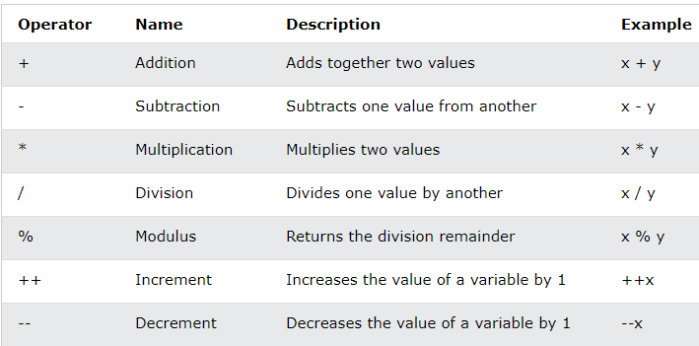
Arithmetic operators
Arithmetic operators are used to perform common mathematical operations.

Slide 18
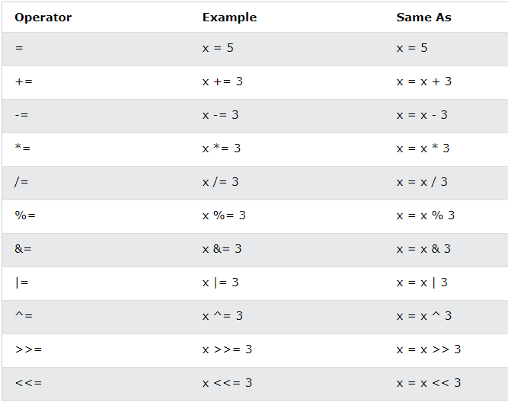
Assignment operators
shdk

Slide 19
Comparison Operators
1.Comparison operators are used to compare two values (or variables).
2.This is important in programming, because it helps us to find answers and make decisions.
3.The return value of a comparison is either 1 or 0, which means true (1) or false (0).

Slide 20
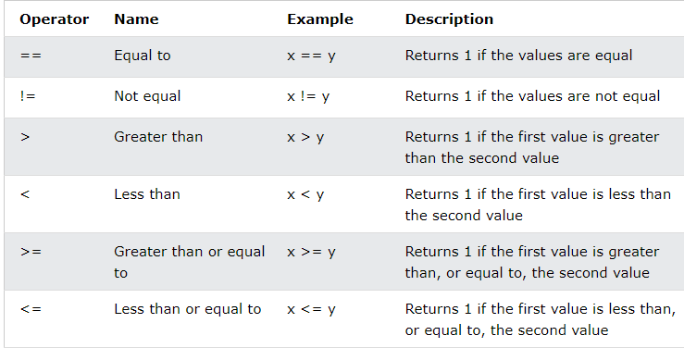
Comparison Operators
sgah

Slide 21
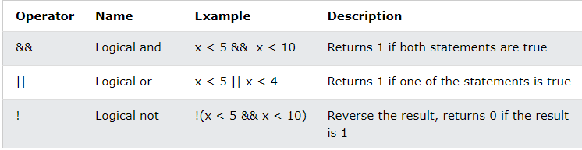
Logical Operators
1.You can also test for true or false values with logical operators.
2.Logical operators are used to determine the logic between variables or values:

Slide 22
Bitwise operator
6 operators are bitwise operators (also known as bit operators as they work at the bit-level).
The & (bitwise AND) in C takes two numbers as operands and does AND on every bit of two numbers. The result of AND is 1 only if both bits are 1.
2.The | (bitwise OR) in C takes two numbers as operands and does OR on every bit of two numbers. The result of OR is 1 if any of the two bits is 1.
3.The ^ (bitwise XOR) in C takes two numbers as operands and does XOR on every bit of two numbers. The result of XOR is 1 if the two bits are different.

Slide 23
Bitwise operator
4.The << (left shift) in C takes two numbers, the left shifts the bits of the first operand, and the second operand decides the number of places to shift.
5.The >> (right shift) in C takes two numbers, right shifts the bits of the first operand, and the second operand decides the number of places to shift.
6.The ~ (bitwise NOT) in C takes one number and inverts all bits of it.

Slide 24
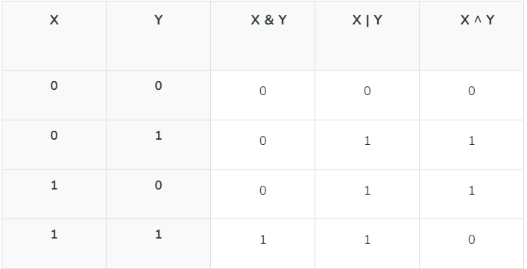
Bitwise operator
gjdj

Slide 25
Jump Statements
The jump statements are continue & Break.
1.Break syntax
int i;
for (i = 0; i < 10; i++) {
if (i == 4) {
break;
}
printf("%d\n", i);
}

Slide 26
Jump Statements
2.Continue syntax:
int i;
for (i = 0; i < 10; i++) {
if (i == 4) {
continue;
}
printf("%d\n", i);
}

Slide 27
Arrays
1.Arrays is the collection of Homogeneous elements.
2.Arrays are used to store multiple values in a single variable, instead of declaring separate variables for each value.
3.To create an array, define the data type (like int) and specify the name of the array followed by square brackets [ ].
4.Syntax of an Array is Data_type array_name[ size_of_an_array ]
Example program:
int myNumbers[] = {25, 50, 75, 100};
printf("%d", myNumbers[0]);
// Outputs 25

Slide 28
Pointers
1.A pointer is a variable that stores the memory address of another variable as its value.
2.Syntax for pointer: datatype * ptr;
Example program: #include <stdio.h>
int main(){
int x;
int *ptr;
x=5;
*ptr=5;
return 0;
}

Slide 29
Functions
1.A function is a block of code which only runs when it is called.
2.You can pass data, known as parameters, into a function.
3.Functions are used to perform certain actions, and they are important for
4.reusing code: Define the code once, and use it many times.
5.Re usability Functions can be stored in library & re-used When some
specific code is to be used more than once, at different places, functions
avoids repetition of the c.
Syntax:void myFunction() {
// code to be executed
}

Slide 30
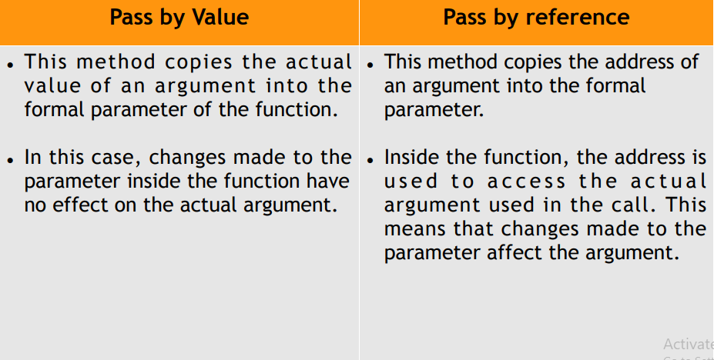
Difference Between Call by value & Call by Reference

Slide 31
Recursive Function
1.Recursion is the technique of making a function call itself.
2.This technique provides a way to break complicated problems down into simple problems which are easier to solve.
Example program: #include<stdio.h>
int sum(int k);
int main() {
int result = sum(3);
printf("%d", result);
return 0;
}

Slide 32
Recursive Function
int sum(int k) {
if (k > 0) {
return k + sum(k - 1);
} else {
return 0;
}
}
// output is 6
3*2*1= 6.

Slide 33
Strings
1.A String is a word in which group of letters.
2.Strings are used for storing text/characters.
For example, "Hello World" is a string of characters.

Slide 34
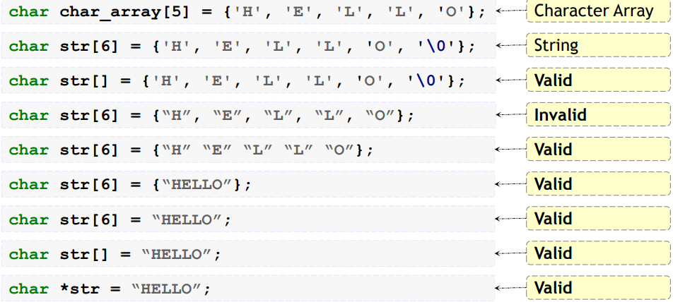
Types of initialization of string

Slide 35
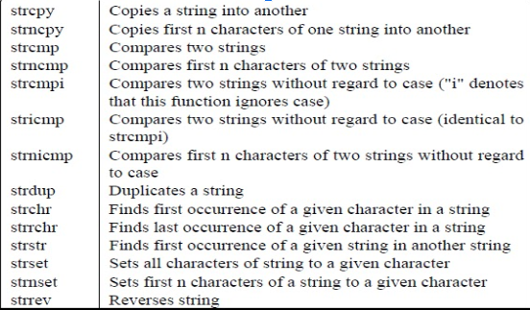
Library Functions of String

Slide 36
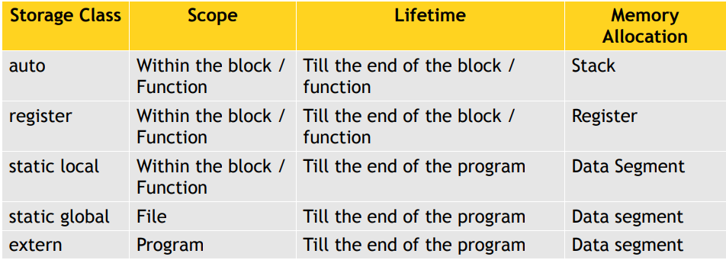
Storage Classes
We have 4 types of storage classes, they are

Slide 37
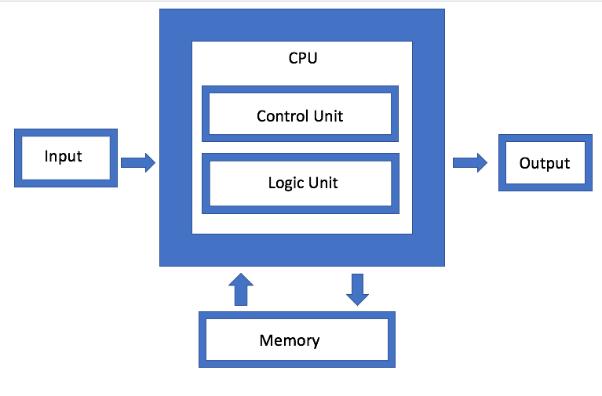
Architecture
1.Von Neumann Architecture
2.Harvard Architecture
Fig-1: Von Neumann Architecture

Slide 38
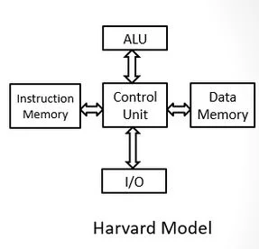
hsdk
Fig-2: Harvard Architecture

Slide 39
Interfacing of LED to Microcontroller
1.We can interface the LED’s to the microcontroller
2.LED - Light Emitting Diode
3.Interfacing of LEDs are 2 types they are
Sourcing Circuit
Sinking Circuit
4. Circuit follows Forward Bias to ON the circuit.
5. Circuit follows Reverse Bias to OFF the circuit.

Slide 40
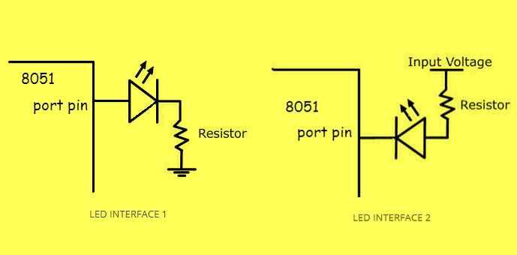
Sourcing Circuit & Sinking Circuit
1. Sourcing Circuit 2. Sinking Circuit
Pin | LED
1 | OFF
0 | ON
Pin | LED
1 | ON
0 | OFF

Slide 41
Interfacing of Switch to Microcontroller
1.We can interface the switch to the microcontroller.
2.Interfacing of switch are 2 types they are
Pull up circuit
Pull Down circuit

Slide 42
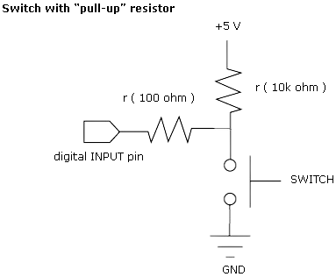
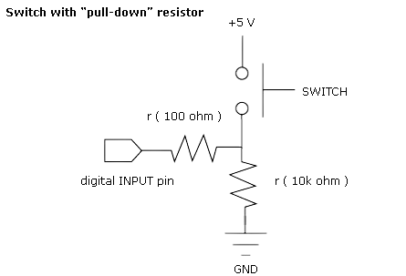
Pull up circuit & Pull Down circuit
agj
Pin | Switch
0 | Pressed
1 | Released
Pin | Switch
0 | Released
1 | Pressed

Slide 43
Detection Type
1. Detection type are 2 types
Level triggering
Edge triggering
2.Level Triggering: To trigger the task based on the value.
Example: Volume button in the remote.
3.Edge Triggering: To trigger the task based on the change in the value.
Example: Power ON/OFF button in the remote.

Slide 44
Interrupts
1.An interrupt is a communication process setup in a microcontroller or microprocessor.
2.An internal or External device requests the MPU to stop the processing.
3.The MPU acknowledge the request.
4.Attends to the request.
5.Goes back to processing where it was interrupted.
6.Interrupt sources - Internal & External Interrupts.
7.Interrupt Handlers - Timers

Slide 45
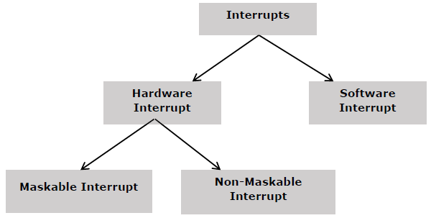
Interrupt Classification

Slide 46
Timers
1.A device for indicating or measuring elapsed time, as a stopwatch.
2.Resolution: width of the timer register. EXample: 8 bit, 16 bit registers.
3.Tick: Up tick, Down Tick.
4.Quantum: Time taken by one tick.
5.System clock settings: Frequency = 20MHz
1 tick = 4 clock pulse = 4 *Time
Time = 4*1/f
Quantum = 4*1/20MHz
=0.2μsec
Time taken = no of ticks * Quantum
Time = 255*200nsec = 51000nsec.

Slide 47
Hidk
Washing machine Project Implementation

Slide 48


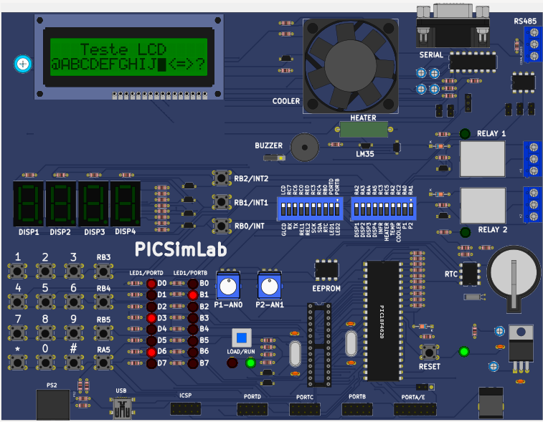
Applications Required
MPLAB X IDE
XC8 COMPILER
PICSIMLAB

Slide 49
Peripherals required for the Project
Switches
Timers
CLCD
Buzzer
Fan

Slide 50
Steps for Implementation
1.Press Key-5 to Power on the screen.
2.Power ON.
3.Washing Program screen, Press key-4 to scroll the options.
4.Long Press on Key-4 to select the option.
5.Water Level program, Press Key-4 to scroll the options.
6.Press key-5 to Start Screen.
7.Displays the washing time on CLCD.
8.Key-1 is for Door status screen in which means to know Door status.
9.Program completed Status it displays Program completed remove clothes.

Slide 51
hakA
THANK YOU
SUBMITTED BY
R.GANESH
SK.ARIEF
K.CHANDANA
P.GURUSAI

